Slide 1
Mushroom Prediction

Slide 2
Objective:
Development of a predictive model for build a solution that should able to predict which mushroom is poisonous & which is edible.
Benefits:
Find which type of mushroom is edible.
Prevent from any food poisoning.

Slide 3
Data Sharing Agreement :
Sample file name (ex mushroomprediction )
Length of date stamp(8 digits)
Length of time stamp(6 digits)
Number of Columns
Column names
Column data type

Slide 4
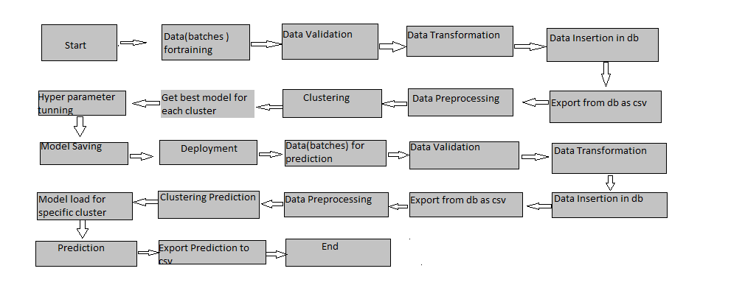
Architecture
Get best model
Classification
Model Load
Classification prediction

Slide 5
Data Validation and Data Transformation :
Identifying and removing missing values: Missing data points can skew model's understanding of the relationships between features. I decide to remove entirely, impute missing values (estimate them based on other data), or encode them as a separate category.
Ensuring data types are consistent: Inconsistent data types (e.g., mixing numbers and text) can lead to errors during model training.
Encoding categorical variables: Convert text-based features (e.g., cap color, spore print color) into numerical representations the model can interpret.

Slide 6
Data Insertion in Database:
Table creation :- Table name “mushrooms" is created in the database for inserting the files. If the table is already present then new files are inserted in the same table.
Insertion of files in the table - All the files in the csv file are inserted in the above-created table. If any file has invalid data type in any of the columns, the file is not loaded in the table

Slide 7
Model Training:
Data Export from Db :
The accumulated data from db is exported in csv format for model training
Data Preprocessing
Performing EDA to get insight of data like identifying distribution , outliers ,trend
among data etc.
Check for null values in the columns. If present impute the null values.
Encode the categorical values with numeric values.
Perform Standard Scalar to scale down the values.

Slide 8
Classification –
To enhance our mushroom edibility prediction, we explored various classification models. These models, like decision trees , support vector machines, Logistic Regression etc. learn from data patterns to categorize new mushrooms. By evaluating different models, we aimed to identify the one that most accurately distinguishes between edible and poisonous varieties based on their characteristics.
Model Selection –
After exploring various classification models, we opted for the decision tree approach. This tree-like structure efficiently analyzes mushroom features to classify them as edible or poisonous.

Slide 9
Prediction:
The testing files are shared in the batches and we perform the same Validation operations ,data transformation and data insertion on them.
The accumulated data from db is exported in csv format for prediction
We perform data pre-processing techniques on it.
Decision Tree Classifier created during training is loaded for the preprocessed data is predicted
Once the prediction is done for all the test data. The predictions are saved in csv format and shared.

Slide 10
Q & A:
Q1) What’s the source of data?
The data for training is provided by the kaggle platform.
Q 2) What was the type of data?
The data was the combination of text data.
Q 3) How logs are managed?
We are using different logs as per the steps that we follow in validation and
modeling like File validation log , Data Insertion ,Model Training log , prediction log
etc.

Slide 11
Q 4) What techniques were you using for data pre-processing?
Removing unwanted attributes
Visualizing relation of independent variables with each other and output variables
Checking and changing Distribution of continuous values
Removing outliers
Cleaning data and imputing if null values are present.
Converting categorical data into numeric values.
Scaling the data

Slide 12
Q 5) How training was done or what models were used?
The scaling was performed over training and validation data
Algorithms like SVM , Decision Tree Classifier, Logistic Regression were used and we saved that final model .
Q 6) How Prediction was done?
Our decision tree model progressively classified mushrooms. At each step, a mushroom's characteristic (e.g., cap shape) determined the next branch, ultimately leading to an "edible" or "poisonous" prediction.

Slide 13
Q 7) What are the different stages of deployment?
Prepare & Package: Package application code and leverage AWS services for automated building and version control.
Provision & Configure: Choose AWS infrastructure (EC2, Lambda, ECS) and configure everything using CloudFormation or IaC templates.
Deploy & Monitor: Deploy application with options like CodeDeploy, monitor its health with CloudWatch, and have a rollback plan ready

